Slide 1

Exploratory Data Analysis
G2M Case Study
Alex Lindberg
18-July-2022

Slide 2
Agenda
Problem Background (4)
Understanding the Problem (5-6)
Assembling the Master (7-13)
Master EDA and Analysis (14- 20)
Recommendations (21)

Slide 3
Problem Background
XYZ is a private firm in US. Due to remarkable growth in the Cab Industry in last few years and multiple key players in the market, it is planning for an investment in Cab industry and as per their Go-to-Market(G2M) strategy they want to understand the market before taking final decision.
We have been provided with multiple datasets on the two companies. We need to analyze these in order to obtain actionable insights which will be presented to XYZ’s Executive team.
We will look at several different areas of the cab industry that we think are important to consider when planning an investment decision.

Slide 4
Understanding the Problem
4 datasets: Cab_Data, City, Customer_ID, Transaction_ID
Two cab companies: Pink Cab and Yellow Cab
Each company operates in the same 19 cities
Time period: 01/01/2016 - 12/31/2018
Two methods of pay: Card and Cash

Slide 5
Assumptions Made
Although the time period stated in the problem was 01/31/2016 to 12/31/2018, I assume the actual time period is 01/01/2016 to 12/31/2018 since the difference between the max and min dates in the Date column is 1095 and there are only 1066 unique calendar days between the posted time period.
I assume the Users feature represents the total number of users in the given city for the two companies combined.
I assume that trips where a customer spent more than 20% of their monthly income on a single ride were outliers and most likely incorrect.
I assume that any trips with the same Customer_ID, Date, Cost, and Revenue were duplicates since it is very unlikely that two trips by the same person in the same day would have all of these features identical.

Slide 6
Assembling the Master Dataset
There were three main steps I took while assembling the master dataset:
Feature Engineering
Joining Tables
Cleaning the Master

Slide 7
Feature Engineering
In total, I created 4 additional features from the ones we were provided:
Profit (How much the company made on a single trip) : [Price Charged - Cost of Trip]
Price per KM (How much the company made per KM on a single trip) : [Price Charged / KM Travelled]
City Per (Percent of city that use one of the two companies) : [Users / Population]
Percent of Income (Percent of monthly income that a customer spends on a single trip) : [Price Charged / Income (USD/Month)

Slide 8
Feature Engineering contd.
Outside of creating new features, we also need to modify the values of some of the features:
Users: delete all commas so the value can be a float instead of a string
Population: delete all commas so the value can be a float instead of a string
Gender: Change male and female to 1 and 0 respectively

Slide 9
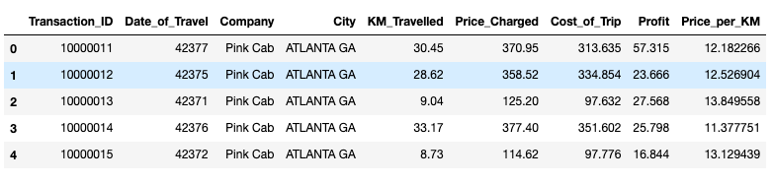
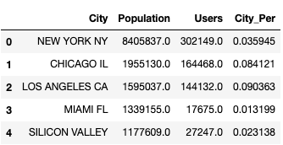
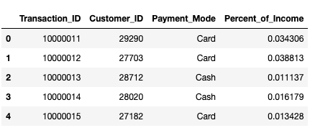
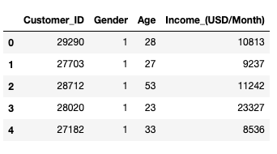
Joining Tables
After engineering the features, our 4 tables look like this:
Cab_Data:
Cities:
Transactions:
Customers:

Slide 10
Joining Tables contd.
We now need to perform a couple joins on these tables:
First, Join on ‘City’ between the cab_data and cities tables.
Next, Join on ‘Customer ID’ between the transactions and customers tables.
Last, join these two created tables on Transaction ID
Let’s take a deeper look at the master dataset we have produced in the next slide.

Slide 11
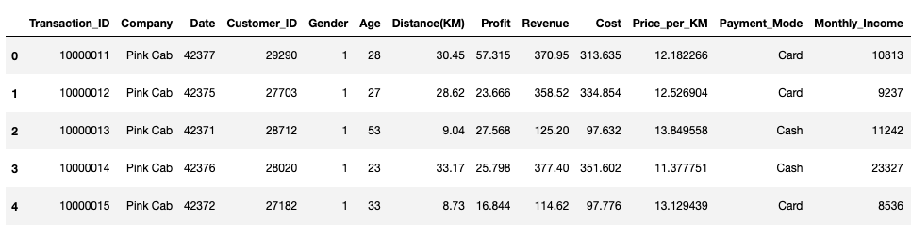
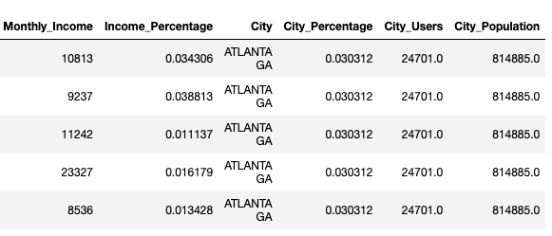
The Master Dataset
359392 entries
18 features
52.1 MB Memory
Master head:
Note: Some of the features were renamed to be shorter or more descriptive *

Slide 12
Cleaning the Master
In order to prepare our master dataset for analysis, it was important that we checked for missing values, outliers, and duplicates.
Missing values: The dataset contained no null or NA values in any rows.
Outliers: Removed all rows with values more than 3 SD’s away from the mean in any given column. (< 5% of total data)
Duplicates: No rows had the same Date, Customer ID, Distance, Cost, and Revenue so we assumed there were no duplicates.
Let’s get into the analysis now.
Note: There were 5 rows with the same Date, Customer ID, and Distance, but this is plausible since a single customer could take two trips to and from the same location in the same day *

Slide 13
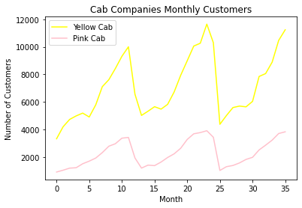
Customer Traffic
Monthly customer traffic is something that we should obviously be a large consideration in our investment decision. In the graph to the left, we see the number of monthly customers for each company of the 36-month time period that we analyzed. It is clear that the Yellow Cab company outperforms the Pink Cab company in every season we can see. (Interesting to note the increase in customers during the colder months of the year)

Slide 14
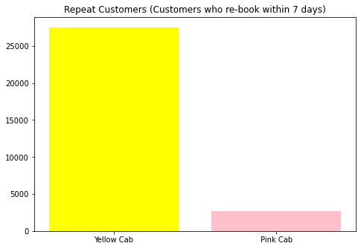
Customer Satisfaction
In the cab company, customer satisfaction after a ride is something that is extremely important in my opinion. To measure this, I looked at the amount of “repeat customers” (customers who re-booked with the same company within the last 7 days of their previous trip) each company had throughout the whole time period. As we can see in the graph to the left, Yellow Cab company has significantly more repeat customers than the Pink Cab company. Because of this, we can make the inference that the Yellow Cab company performs much better in the area of customer satisfaction.

Slide 15
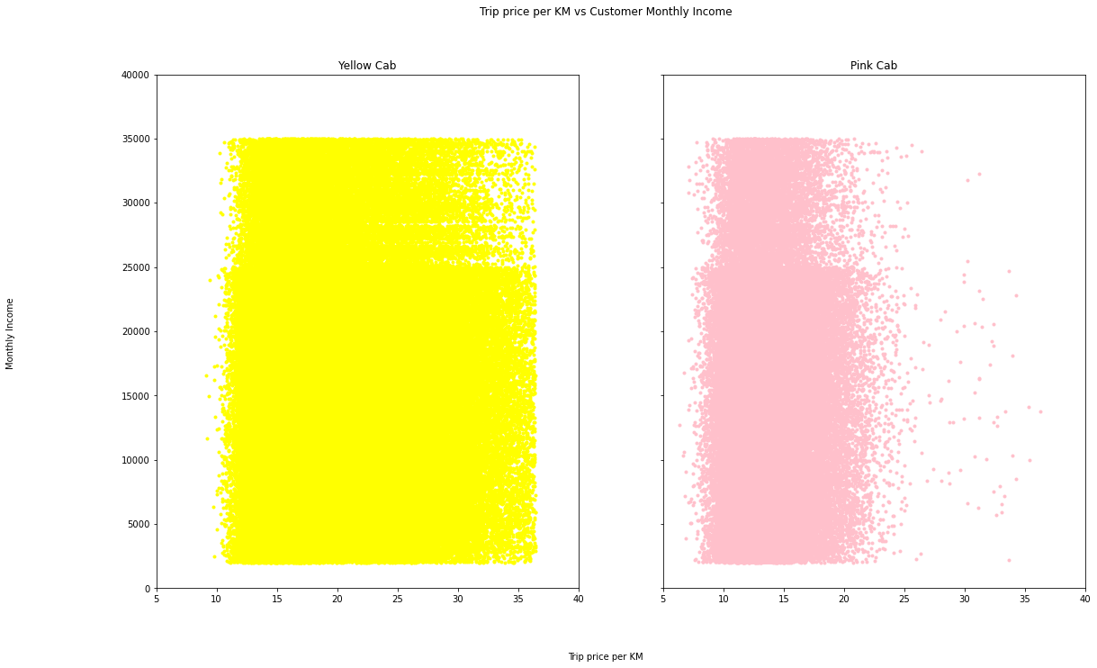
Trip Diversity
Another big factor that we should consider is the diversity of the trips for each company. Obviously, it is valuable to have lots of trips with high price per KM, but the company that we invest in shouldn’t rely solely on them. Additionally, the ideal company should not solely rely on customers in one income group. In this graph, we can see that the Yellow Cab Company is much more diverse in the price of their trips per KM, whereas the Pink Cab Company is skewed to the lower priced trips per KM, which can be seen as an advantage for the Yellow Cab Company.

Slide 16
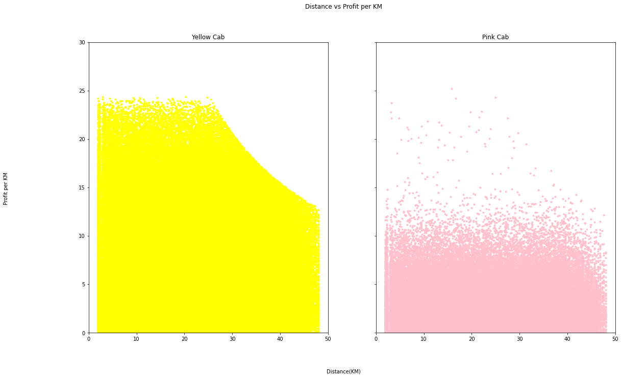
Trip Efficiency
Ideally, we would like to invest in the company that consistently brings in more profit per KM no matter what the distance of the trip is. In this graph we can see that at every trip distance, the Yellow Cab company has a much higher amount of efficient trips than the Pink Cab company. This represents another advantage for the Yellow Cab company.

Slide 17
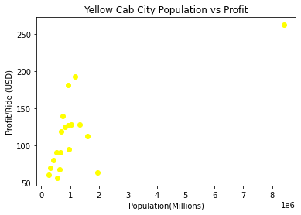
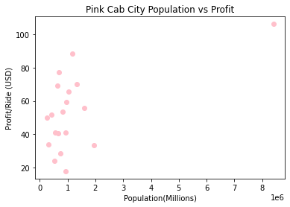

“Big City Presence”
For both companies, we can see that there tends to be a positive relationship between city population and average profit per ride in that respective city. Because of this, it’s important that we analyze the presence of each company in big cities. I’ve created a metric called “Big City Score” (BCS) that quantifies each company’s big city presence. The calculation of this metric and each company’s score can be seen to the left.
Big City Score =
Yellow Cab Company BCS = 31830
Pink Cab Company BCS = 27303

Slide 18
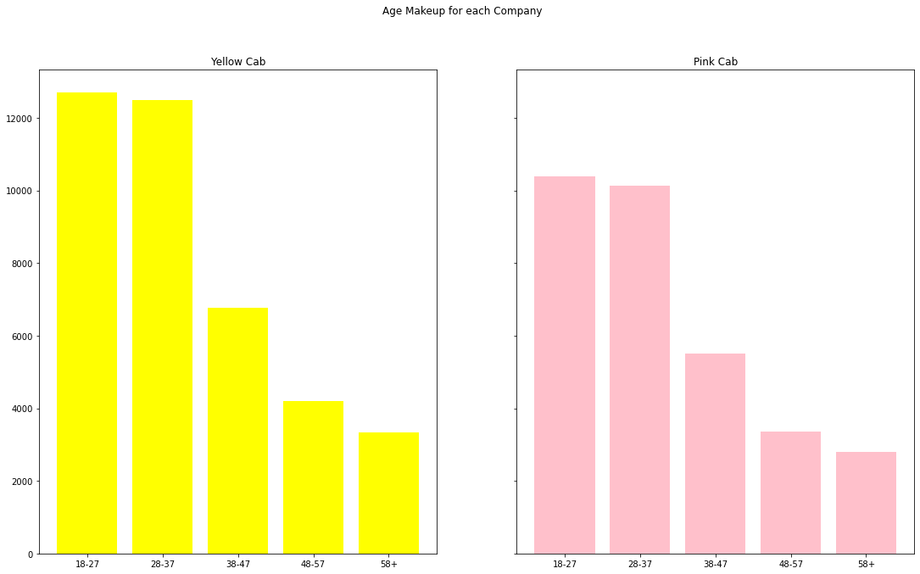
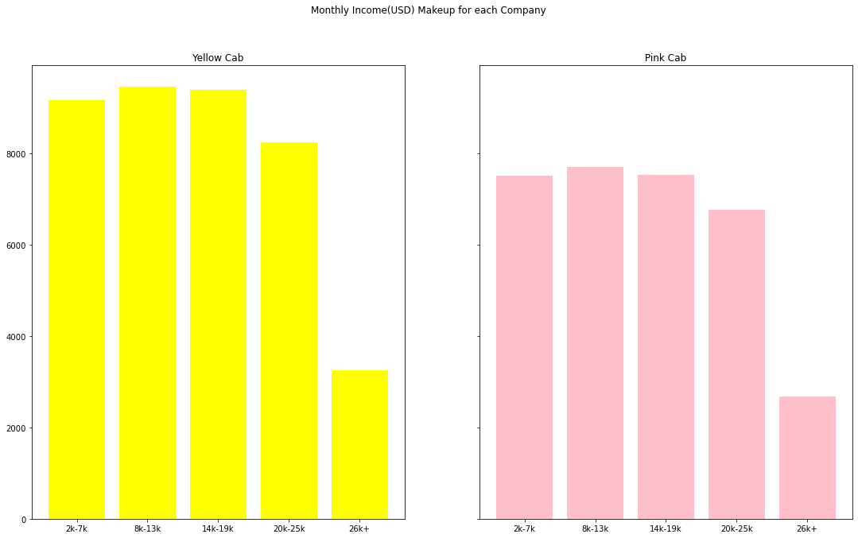
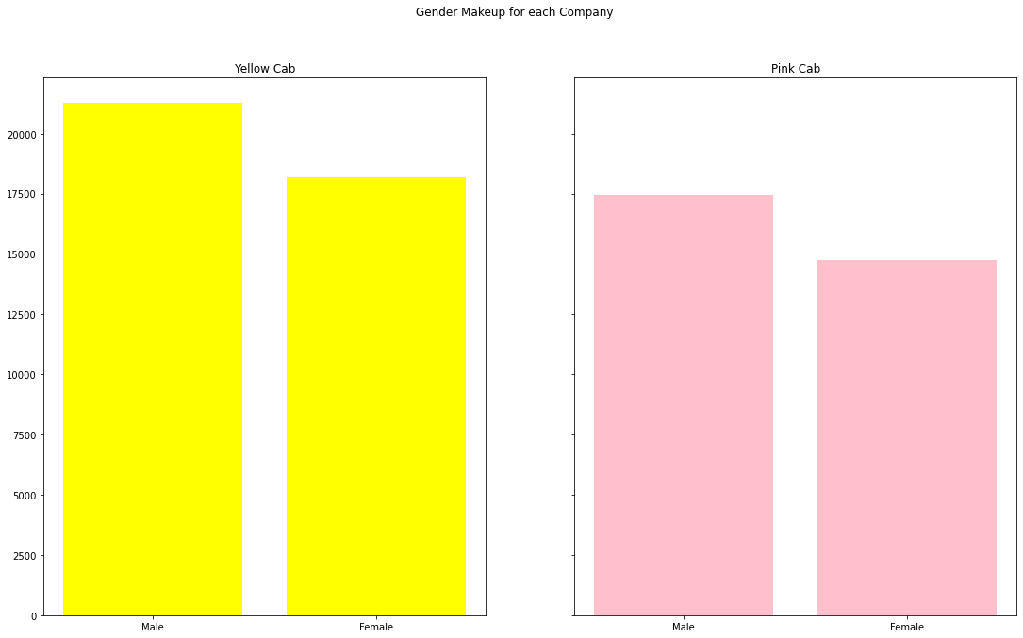
Client Diversity

Slide 19
Client Diversity contd.
It’s important for every business to have diverse clients so that they don’t rely on any single demographic and instead bring in revenue from lots of different types of people. In the graphs from the previous side, we can see that the client makeups are very similar for both companies. For this reason, we will not give either an advantage in this category.

Slide 20
Recommendations
We analyzed the two cab companies in each of the following areas:
Customer Traffic
Customer Satisfaction
Trip Diversity
Trip Efficiency
“Big City Presence”
Client Diversity
In all but one of these areas, the Yellow Cab Company outperformed the Pink Cab Company. For this reason, I can confidently say that my informed recommendation will be to invest in the Yellow Cab Company.

Slide 21
Thank You

